Slide 1
GIS To AERMOD Tool

Slide 2
Tool Description
Converting Roadway GIS Layer to AERMOD Geometry

Slide 3
UI Design (1) – Data Import Module
GTA (GIS-TO-AERMOD)
Data
Road
Receptors
Emissions
Compilation
Results
Open
Import
D:\Research 2021\GIS.shp
1. Choose Columns from Shape File
2. Origin and Destination
Road Unique ID
RDId ▼
Shoulder (m)
Origin EPSG (4-digit)
Road Type
rdtype ▼
Geometry
geometry ▼
Destination EPSG (4-digit)
Number of Lanes
LANES ▼
Unit of destination EPSG
meter or ft ▼
Lane Width
Ln width▼
Note EPSG code can be found in: https://spatialreference.org/ref/epsg/
3. Locate boundary and reference point
Locate from graph
y high
X left
X right
Reference
Verify inputs in this page
y low

Slide 4
UI Design (1) – Data Import Module
GTA (GIS-TO-AERMOD)
Locate and import GIS shape file
Ln 90-95
Data
Road
Receptors
Emissions
Compilation
Results
Open
Import
D:\Research 2021\GIS.shp
Ln 76: rd_edge
1. Choose Columns from Shape File
2. Origin and Destination
Ln 22: from_proj
Road Unique ID
RDId ▼
Shoulder (m)
Origin EPSG (4-digit)
Locate colume
Ln 80: GISRdID
Ln 86: L_tp
Ln 82: L_num
Ln 84: L_wd
Destination EPSG (4-digit)
Ln 23: to_proj
Road Type
rdtype ▼
Geometry
geometry ▼
Number of Lanes
LANES ▼
Unit of destination EPSG
meter or ft ▼
Choose either meter or ft
Ln 27-31: unit
Lane Width
Ln width▼
Note EPSG code can be found in: https://spatialreference.org/ref/epsg/
3. Locate boundary and reference point
Locate from graph
y high
X left
X right
Reference
Verify inputs in this page
y low

Slide 5
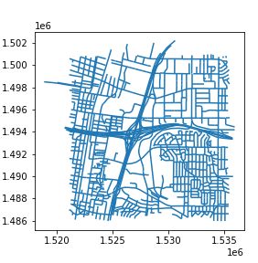
UI Design (1) – Data Import Module
Locate boundary and reference point
Draw boundary
GTA (GIS-TO-AERMOD)
Data
Road
Receptors
Emissions
Compilation
Can Zoom in/out
Help
Locate reference point
Open
Import
D:\Research 2021\GIS.shp
1. Choose Columns from Shape File
2. Origin and Destination
Road Unique ID
RDId ▼
Shoulder (m)
Origin EPSG (4-digit)
Road Type
rdtype ▼
Geometry
geometry ▼
Destination EPSG (4-digit)
Number of Lanes
LANES ▼
Unit of destination EPSG
Meter or ft ▼
Lane Width
Ln width▼
Note EPSG code can be found in: https://spatialreference.org/ref/epsg/
Show the whole graph
3. Locate boundary and reference point
Locate from graph
y high
Confirm & close
X left
X right
Reference
Verify inputs in this page
y low

Slide 6
UI Design (2) – Boundary and Referencing
1 Click this button, we can then draw a box to identify boundaries variables:
Ln 37-40: x_leftb, x_rightb, y_lowerb, y_higherb
If they want to re-do boundary, just repeat
Locate boundary and reference point
Draw boundary
x_leftb
x_rightb
Can Zoom in/out
y_higherb
Locate reference point
2 Click this button, we can then click any point in the map as reference point:
Ln 73-74: x_0, y_0
If they want to re-do, just repeat
1
When users zoomed in map and then want to step back to see the whole network view, click this button
2
y_lowerb
Show the whole graph
This button confirm that you have chosen the boundaries and references, and close this window, move back to main Data window.
If users didn’t choose boundary or locate reference, then should pop a window box to remind.
Confirm & close

Slide 7
UI Design (1) – Data Import Module
GTA (GIS-TO-AERMOD)
Data
Road
Receptors
Emissions
Compilation
Results
Open
Import
D:\Research 2021\GIS.shp
1. Choose Columns from Shape File
2. Origin and Destination
Then this button is:
1: verify users input everything in this page, if anything is missing, remind users
2: convert coordinates (Code Ln 100-139), a new window box showing the “Please wait while converting coordinate information…”
3: when conversion done, a new window box showing “conversion done! You may move to ‘Road’ module”
Road Unique ID
RDId ▼
Shoulder (m)
Origin EPSG (4-digit)
Road Type
rdtype ▼
Geometry
geometry ▼
Destination EPSG (4-digit)
Number of Lanes
LANES ▼
Unit of destination EPSG
Meter or ft ▼
Lane Width
Ln width▼
Note EPSG code can be found in: https://spatialreference.org/ref/epsg/
3. Locate boundary and reference point
Locate from graph
y high
X left
X right
Reference
Verify inputs in this page
y low
After you locate reference and finish conversion, the boundary values and reference values should show in these textboxes, users can also change values on it

Slide 8
UI Design (3) – Road Module
GTA (GIS-TO-AERMOD)
Data
Road
Receptors
Emissions
Compilation
Results
Line (LINE, RLINE, RLINEXT)
AREA
VOLUME
Line includes LINE, RLINE and RLINEXT. The geometries of line sources are defined with coordinates of two end points and line width.
AREA geometry is defined in AERMOD as a polygon with coordinates of up to 20 vertices
VOLUME is defined by the coordinates of the source center and cell size (d)
Graphic example
Graphic example
Graphic example
VOLUME columns
LINE columns
AREA columns
Max Size (m)
Should <= 8 m
Generate Line
Generate AREA
Generate VOLUME
Visualize Line
Visualize AREA
Visualize VOLUME

Slide 9
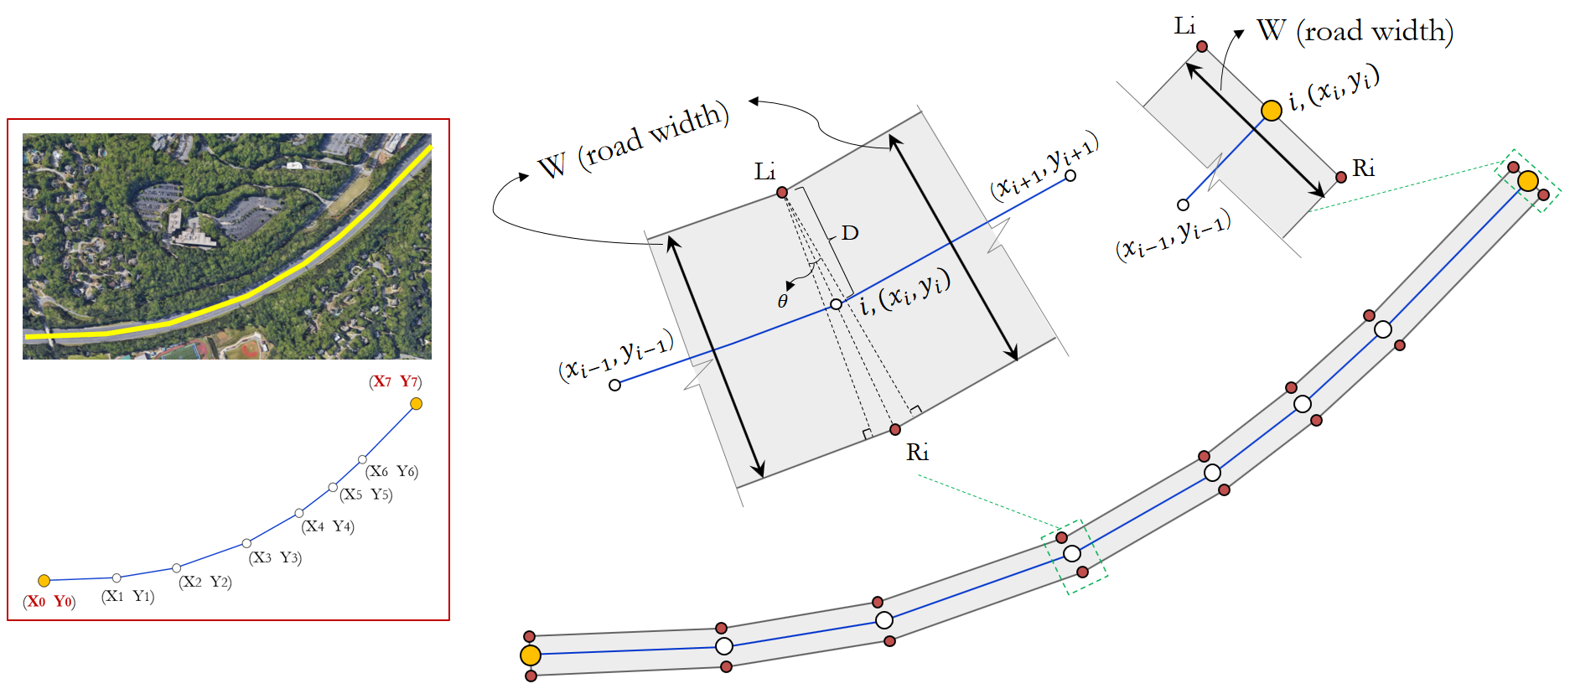
UI Design (3) – Road Module
Line Source Geometry
GTA (GIS-TO-AERMOD)
Data
Road
Receptors
Emissions
Compilation
Help
Line (LINE, RLINE, RLINEXT)
AREA
VOLUME
Line includes LINE, RLINE and RLINEXT. The geometries of line sources are defined with coordinates of two end points and line width.
AREA geometry is defined in AERMOD as a polygon with coordinates of up to 20 vertices
VOLUME is defined by the coordinates of the source center and cell size (d)
Click this button can show a new window with this picture
Graphic example
Graphic example
Graphic example
VOLUME columns
LINE columns
AREA columns
Max Size (m)
Should <= 8 m
Generate Line
Generate AREA
Generate VOLUME
Visualize Line
Visualize AREA
Visualize VOLUME

Slide 10
UI Design (3) – Road Module
“Line.csv” Features Explained
Col A: Link ID from GIS
Col B – linkID: new assigned link ID
Col C – linkID_new: new assigned source ID
Col D – F_LTYPE: road class from GIS
Col E – wd: road width in meters, defined as (number of lanes × lane width + shoulder)
Col F – bw: road width in meters divided by 2
Col G – area: area of source surface in meters^2
Col H – geometry: geometry of line source
Col I – coord_aer: geometry of line source in form of AERMOD
GTA (GIS-TO-AERMOD)
Data
Road
Receptors
Emissions
Compilation
Help
Line (LINE, RLINE, RLINEXT)
AREA
VOLUME
Line includes LINE, RLINE and RLINEXT. The geometries of line sources are defined with coordinates of two end points and line width.
AREA geometry is defined in AERMOD as a polygon with coordinates of up to 20 vertices
VOLUME is defined by the coordinates of the source center and cell size (d)
Graphic example
Click this button can show a new window with these text
Graphic example
Graphic example
VOLUME columns
LINE columns
AREA columns
Max Size (m)
Should <= 8 m
Generate Line
Generate AREA
Generate VOLUME
Visualize Line
Visualize AREA
Visualize VOLUME

Slide 11
UI Design (3) – Road Module
GTA (GIS-TO-AERMOD)
Data
Road
Receptors
Emissions
Compilation
Results
Line (LINE, RLINE, RLINEXT)
AREA
VOLUME
Line includes LINE, RLINE and RLINEXT. The geometries of line sources are defined with coordinates of two end points and line width.
AREA geometry is defined in AERMOD as a polygon with coordinates of up to 20 vertices
VOLUME is defined by the coordinates of the source center and cell size (d)
Graphic example
1 Generate Line source file and save as “Line.csv”
Ln: 252-311
Graphic example
Graphic example
VOLUME columns
LINE columns
AREA columns
Max Size (m)
Should <= 8 m
Generate Line
Generate AREA
Generate VOLUME
Visualize Line
Visualize AREA
Visualize VOLUME
2 Visualize Line source using “Line.csv”
Ln: 315-337

Slide 12

UI Design (3) – Road Module
AREA Source Geometry
GTA (GIS-TO-AERMOD)
Data
Road
Receptors
Emissions
Compilation
Help
Line (LINE, RLINE, RLINEXT)
AREA
VOLUME
Line includes LINE, RLINE and RLINEXT. The geometries of line sources are defined with coordinates of two end points and line width.
AREA geometry is defined in AERMOD as a polygon with coordinates of up to 20 vertices
VOLUME is defined by the coordinates of the source center and cell size (d)
Click this button can show a new window with this picture
Graphic example
Graphic example
Graphic example
VOLUME columns
LINE columns
AREA columns
Max Size (m)
Should <= 8 m
Generate Line
Generate AREA
Generate VOLUME
Visualize Line
Visualize AREA
Visualize VOLUME

Slide 13
“AREA.csv” Features Explained
UI Design (3) – Road Module
Col A: Link ID from GIS
Col B – linkID: new assigned link ID
Col C – linkID_new: new assigned source ID
Col D – F_LTYPE: road class from GIS
Col E – wd: road width in meters, defined as (number of lanes × lane width + shoulder)
Col F – bw: road width in meters divided by 2
Col G – area: area of source surface in meters^2
Col H – x_ini: original x coord
Col I – y_ini: original y coord
Col J – n: number of polygon vertices
Col K – poly: geometry of polygon AREA
Col L – geometry: geometry of AREA source
Col M – coord: coordinates of AREA source
Col N – vertex_aer: original coord in form of AERMOD
Col O – coord_aer: geometry of AREA source in form of AERMOD
GTA (GIS-TO-AERMOD)
Data
Road
Receptors
Emissions
Compilation
Help
Line (LINE, RLINE, RLINEXT)
AREA
VOLUME
Line includes LINE, RLINE and RLINEXT. The geometries of line sources are defined with coordinates of two end points and line width.
AREA geometry is defined in AERMOD as a polygon with coordinates of up to 20 vertices
VOLUME is defined by the coordinates of the source center and cell size (d)
Graphic example
Click this button can show a new window with these text
Graphic example
Graphic example
VOLUME columns
LINE columns
AREA columns
Max Size (m)
Should <= 8 m
Generate Line
Generate AREA
Generate VOLUME
Visualize Line
Visualize AREA
Visualize VOLUME

Slide 14
UI Design (3) – Road Module
GTA (GIS-TO-AERMOD)
Data
Road
Receptors
Emissions
Compilation
Results
Line (LINE, RLINE, RLINEXT)
AREA
VOLUME
Line includes LINE, RLINE and RLINEXT. The geometries of line sources are defined with coordinates of two end points and line width.
AREA geometry is defined in AERMOD as a polygon with coordinates of up to 20 vertices
VOLUME is defined by the coordinates of the source center and cell size (d)
Graphic example
Graphic example
Graphic example
VOLUME columns
LINE columns
AREA columns
Max Size (m)
Should <= 8 m
Generate Line
Generate AREA
Generate VOLUME
Visualize Line
Visualize AREA
Visualize VOLUME
1 Generate AREA source file and save as “AREA.csv”
Ln: 145-222
2 Visualize Line source using “AREA.csv”
Ln: 225-249

Slide 15
UI Design (3) – Road Module
GTA (GIS-TO-AERMOD)
Data
Road
Receptors
Emissions
Compilation
Results
Line (LINE, RLINE, RLINEXT)
AREA
VOLUME
Line includes LINE, RLINE and RLINEXT. The geometries of line sources are defined with coordinates of two end points and line width.
AREA geometry is defined in AERMOD as a polygon with coordinates of up to 20 vertices
VOLUME is defined by the coordinates of the source center and cell size (d)
0 type the maximum size (meter) of VOLUME parcel
Ln 405: max_vol
Graphic example
Graphic example
Graphic example
VOLUME columns
LINE columns
AREA columns
Max Size (m)
Should <= 8 m
Generate Line
Generate AREA
Generate VOLUME
1 Generate VOLUME source file and save as “VOLUME_X.csv”
Ln: 355-430
Visualize Line
Visualize AREA
Visualize VOLUME
2 Visualize Line source using “VOLUME_X.csv”
Ln: 434-472

Slide 16
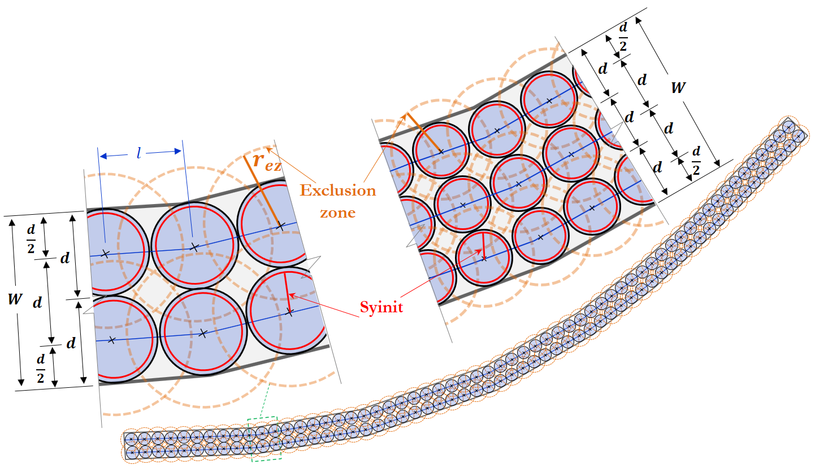
VOLUME Source Geometry
UI Design (3) – Road Module
GTA (GIS-TO-AERMOD)
Data
Road
Receptors
Emissions
Compilation
Results
Line (LINE, RLINE, RLINEXT)
AREA
VOLUME
Line includes LINE, RLINE and RLINEXT. The geometries of line sources are defined with coordinates of two end points and line width.
AREA geometry is defined in AERMOD as a polygon with coordinates of up to 20 vertices
VOLUME is defined by the coordinates of the source center and cell size (d)
Click this button can show a new window with this picture
Graphic example
Graphic example
Graphic example
VOLUME columns
LINE columns
AREA columns
Max Size (m)
Should <= 8 m
Generate Line
Generate AREA
Generate VOLUME
Visualize Line
Visualize AREA
Visualize VOLUME

Slide 17
UI Design (3) – Road Module
GTA (GIS-TO-AERMOD)
Data
Road
Receptors
Emissions
Compilation
Results
“VOLUME_XX.csv” Features Explained
Col A: Link ID from GIS
Col B – linkID: new assigned link ID
Col C – linkID_new: new assigned source ID
Col D – geometry: geometry of VOLUME center
Col E – nn: number of VOLUME cells from the link
Col F – subwd: size of VOLUME
Col G – coord_aer: coord of VOLUME center in form of AERMOD
Col H – yinit: initial lateral dispersion coefficient
VOLUME
Line (LINE, RLINE, RLINEXT)
AREA
Line includes LINE, RLINE and RLINEXT. The geometries of line sources are defined with coordinates of two end points and line width.
AREA geometry is defined in AERMOD as a polygon with coordinates of up to 20 vertices
VOLUME is defined by the coordinates of the source center and cell size (d)
Graphic example
Graphic example
Graphic example
VOLUME columns
LINE columns
AREA columns
Max Size (m)
Should <= 8 m
Click this button can show a new window with these text
Generate Line
Generate AREA
Generate VOLUME
Visualize Line
Visualize AREA
Visualize VOLUME

Slide 18
UI Design (4) – Road Module
GTA (GIS-TO-AERMOD)
Data
Road
Receptors
Emissions
Compilation
Results
Line (LINE, RLINE, RLINEXT)
AREA
VOLUME
Line includes LINE, RLINE and RLINEXT. The geometries of line sources are defined with coordinates of two end points and line width.
AREA geometry is defined in AERMOD as a polygon with coordinates of up to 20 vertices
VOLUME is defined by the coordinates of the source center and cell size (d)
0 type the maximum size (meter) of VOLUME parcel
Ln 405: max_vol
Graphic example
Graphic example
Graphic example
VOLUME columns
LINE columns
AREA columns
Max Size (m)
Should <= 8 m
Generate Line
Generate AREA
Generate VOLUME
1 Generate VOLUME source file and save as “VOLUME_X.csv”
Ln: 355-430
Visualize Line
Visualize AREA
Visualize VOLUME
2 Visualize Line source using “VOLUME_X.csv”
Ln: 434-472

Slide 19
UI Design (5) – Receptors Module
GTA (GIS-TO-AERMOD)
Data
Road
Receptors
Emissions
Compilation
Results
Information for receptors
Input for receptors generation
There are two types of receptors that can be automatically generated.
1. Near-road receptors:
Upload csv
1.1. Import from csv file
1. Near-road receptors: receptors around roadways. Define number of layers and space intervals by uploading csv or using table:
F_LTYPE: road type matched in GIS
LAYER: layer ID (1,2,3,..)
DISTANCE: distance (m) of layer from road edge (usually the closest layer = 5 m)
INTERVAL: space intervals within each layer
D:\Research 2021\receptor_layers.csv
or
1.2. Type layers information:
F_LTYPE | LAYER | DISTANCE | INTERVAL
2. Gridded receptors with space intervals specified on the right.
2. Gridded - interval (SG in m)
3. Elevation of receptors (m) above road ground, 1.5 m recommended.
3. Receptor elevations
Graphic example
Generate receptors
Visualize receptors

Slide 20
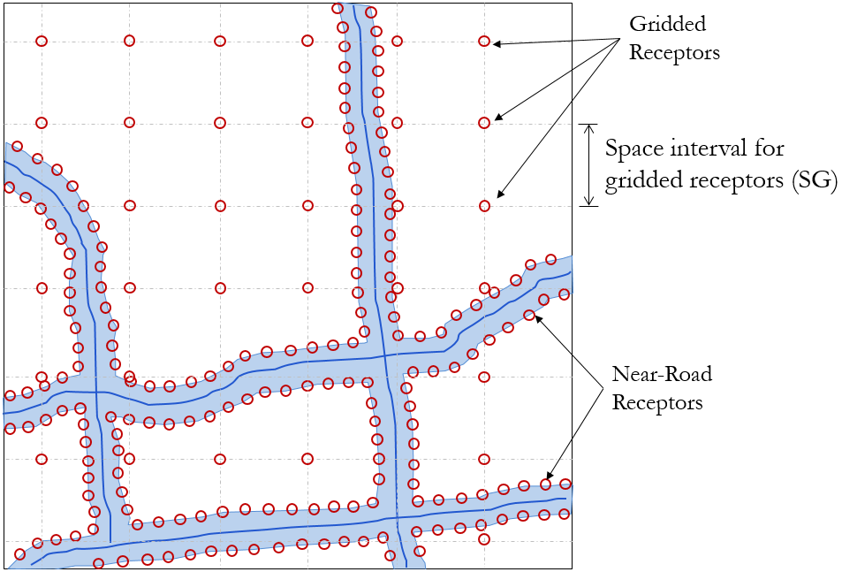
UI Design (5) – Receptors Module
Near-road and Gridded Receptors
GTA (GIS-TO-AERMOD)
Data
Road
Receptors
Emissions
Compilation
Results
Information for receptors
Input for receptors generation
There are two types of receptors that can be automatically generated.
1. Near-road receptors:
Upload csv
1.1. Import from csv file
1. Near-road receptors: receptors around roadways. Define number of layers and space intervals by uploading csv or using table:
F_LTYPE: road type matched in GIS
LAYER: layer ID (1,2,3,..)
DISTANCE: distance (m) of layer from road edge (usually the closest layer = 5 m)
INTERVAL: space intervals within each layer
D:\Research 2021\receptor_layers.csv
or
1.2. Type layers information:
F_LTYPE | LAYER | DISTANCE | INTERVAL
2. Gridded receptors with space intervals specified on the right.
2. Gridded - interval (SG in m)
3. Elevation of receptors (m) above road ground, 1.5 m recommended.
3. Receptor elevations
Graphic example
Generate receptors
Visualize receptors
Click this button can show a new window with this picture

Slide 21
UI Design (5) – Receptors Module
GTA (GIS-TO-AERMOD)
Data
Road
Receptors
Emissions
Compilation
Results
Information for receptors
Input for receptors generation
There are two types of receptors that can be automatically generated.
1. Near-road receptors:
Users can either use the button to upload csv and fill the table, or directly type it in the table. The “F_LTYPE” needs to be matched with information in GIS column “road type” in Data Module. DISTANCE and INTERVAL needs to be numeric in ‘float’ or ‘int’. CL 480-481, when we load data in the table to “rec_lyr” dataframe
Upload csv
1.1. Import from csv file
1. Near-road receptors: receptors around roadways. Define number of layers and space intervals by uploading csv or using table:
F_LTYPE: road type matched in GIS
LAYER: layer ID (1,2,3,..)
DISTANCE: distance (m) of layer from road edge (usually the closest layer = 5 m)
INTERVAL: space intervals within each layer
D:\Research 2021\receptor_layers.csv
or
1.2. Type layers information:
F_LTYPE | LAYER | DISTANCE | INTERVAL
2. Gridded receptors with space intervals specified on the right.
2. Gridded - interval (SG in m)
3. Elevation of receptors (m) above road ground, 1.5 m recommended.
3. Receptor elevations
Graphic example
Generate receptors
Visualize receptors

Slide 22
UI Design (5) – Receptors Module
GTA (GIS-TO-AERMOD)
Data
Road
Receptors
Emissions
Compilation
Results
Information for receptors
Input for receptors generation
There are two types of receptors that can be automatically generated.
1. Near-road receptors:
Upload csv
1.1. Import from csv file
1. Near-road receptors: receptors around roadways. Define number of layers and space intervals by uploading csv or using table:
F_LTYPE: road type matched in GIS
LAYER: layer ID (1,2,3,..)
DISTANCE: distance (m) of layer from road edge (usually the closest layer = 5 m)
INTERVAL: space intervals within each layer
D:\Research 2021\receptor_layers.csv
or
1.2. Type layers information:
F_LTYPE | LAYER | DISTANCE | INTERVAL
CL 479, variable ‘rec_grid_interval’. needs to be numeric in ‘float’ or ‘int’.
2. Gridded receptors with space intervals specified on the right.
2. Gridded - interval (SG in m)
3. Elevation of receptors (m) above road ground, 1.5 m recommended.
3. Receptor elevations
Graphic example
Generate receptors
Visualize receptors

Slide 23
UI Design (5) – Receptors Module
GTA (GIS-TO-AERMOD)
Data
Road
Receptors
Emissions
Compilation
Results
Information for receptors
Input for receptors generation
There are two types of receptors that can be automatically generated.
1. Near-road receptors:
Upload csv
1.1. Import from csv file
1. Near-road receptors: receptors around roadways. Define number of layers and space intervals by uploading csv or using table:
F_LTYPE: road type matched in GIS
LAYER: layer ID (1,2,3,..)
DISTANCE: distance (m) of layer from road edge (usually the closest layer = 5 m)
INTERVAL: space intervals within each layer
D:\Research 2021\receptor_layers.csv
or
1.2. Type layers information:
F_LTYPE | LAYER | DISTANCE | INTERVAL
2. Gridded receptors with space intervals specified on the right.
2. Gridded - interval (SG in m)
CL 481, variable ‘rec_z’. needs to be numeric in ‘float’ or ‘int’.
3. Elevation of receptors (m) above road ground, 1.5 m recommended.
3. Receptor elevations
Graphic example
Generate receptors
Visualize receptors

Slide 24
UI Design (5) – Receptors Module
GTA (GIS-TO-AERMOD)
Data
Road
Receptors
Emissions
Compilation
Results
Information for receptors
Input for receptors generation
There are two types of receptors that can be automatically generated.
1. Near-road receptors:
Upload csv
1.1. Import from csv file
1. Near-road receptors: receptors around roadways. Define number of layers and space intervals by uploading csv or using table:
F_LTYPE: road type matched in GIS
LAYER: layer ID (1,2,3,..)
DISTANCE: distance (m) of layer from road edge (usually the closest layer = 5 m)
INTERVAL: space intervals within each layer
D:\Research 2021\receptor_layers.csv
or
1.2. Type layers information:
F_LTYPE | LAYER | DISTANCE | INTERVAL
2. Gridded receptors with space intervals specified on the right.
2. Gridded - interval (SG in m)
3. Elevation of receptors (m) above road ground, 1.5 m recommended.
3. Receptor elevations
Graphic example
Generate receptors
Visualize receptors
CL 482-610, generate receptors and store into csv. Need users to select a location, file name, as store it.

Slide 25
UI Design (5) – Receptors Module
GTA (GIS-TO-AERMOD)
Data
Road
Receptors
Emissions
Compilation
Results
Information for receptors
Input for receptors generation
There are two types of receptors that can be automatically generated.
1. Near-road receptors:
Upload csv
1.1. Import from csv file
1. Near-road receptors: receptors around roadways. Define number of layers and space intervals by uploading csv or using table:
F_LTYPE: road type matched in GIS
LAYER: layer ID (1,2,3,..)
DISTANCE: distance (m) of layer from road edge (usually the closest layer = 5 m)
INTERVAL: space intervals within each layer
D:\Research 2021\receptor_layers.csv
or
1.2. Type layers information:
F_LTYPE | LAYER | DISTANCE | INTERVAL
2. Gridded receptors with space intervals specified on the right.
2. Gridded - interval (SG in m)
3. Elevation of receptors (m) above road ground, 1.5 m recommended.
3. Receptor elevations
Graphic example
Generate receptors
Visualize receptors
CL 614-632, visualize the generated receptors

Slide 26
UI Design (6) – Emission Module
GTA (GIS-TO-AERMOD)
Data
Road
Receptors
Emissions
Compilation
Results
Information for emissions
Skip the “Emission Module”
“Emission Module” can be skipped if emission information is not available. Users can still generate AERMOD road geometry and receptors with the tool.
To generate link-level emissions:
Input for Emission Conversion
1. Select link emission column and unit in GIS
Emission
Emission ▼
Select GIS column for link emission info, and emission units in rate (g per mile per hour) or inventory (g per link per hour)
Em Unit
g/mile/hr or g/link/hr ▼
2. Which source(s) do you want to generate emissions for?
2. Select source(s) you want to generate emissions for
“em_AREA.csv” from “AREA.csv”
“em_LINE.csv” from “Line.csv”
“em_RLINEXT.csv” from “Line.csv”
“em_VOLUME_XX.csv” Need to upload VOLUME csv for emissions generation
AREA
LINE or RLINE
RLINEXT
VOLUME
Upload VOLUME csv
Verify input and generate emission

Slide 27
UI Design (6) – Emission Module
GTA (GIS-TO-AERMOD)
If this one is checked, all the input option below are disabled, variable: “run_em_module”
Data
Road
Receptors
Emissions
Compilation
Results
Information for emissions
Skip the “Emission Module”
“Emission Module” can be skipped if emission information is not available. Users can still generate AERMOD road geometry and receptors with the tool.
To generate link-level emissions:
Input for Emission Conversion
1. Select link emission column and unit in GIS
Choose a column from GIS file as link emissions. Variable: “Em”. CL 89
Emission
Emission ▼
Select GIS column for link emission info, and emission units in rate (g per mile per hour) or inventory (g per link per hour)
Em Unit
g/mile/hr or g/link/hr ▼
2. Which source(s) do you want to generate emissions for?
Choose either g/mile/hr or g/link/hr
Variable: “em_unit”. CL 643
2. Select source(s) you want to generate emissions for
“em_AREA.csv” from “AREA.csv”
“em_LINE.csv” from “Line.csv”
“em_RLINEXT.csv” from “Line.csv”
“em_VOLUME_XX.csv” Need to upload VOLUME csv for emissions generation
AREA
LINE or RLINE
RLINEXT
VOLUME
Upload VOLUME csv
Verify input and generate emission

Slide 28
UI Design (6) – Emission Module
GTA (GIS-TO-AERMOD)
Data
Road
Receptors
Emissions
Compilation
Results
Information for emissions
Skip the “Emission Module”
“Emission Module” can be skipped if emission information is not available. Users can still generate AERMOD road geometry and receptors with the tool.
To generate link-level emissions:
Input for Emission Conversion
1. Select link emission column and unit in GIS
If checked, variable ‘AREA_em’ is True, otherwise False.
Emission
Emission ▼
Select GIS column for link emission info, and emission units in rate (g per mile per hour) or inventory (g per link per hour)
Em Unit
g/mile/hr or g/link/hr ▼
2. Which source(s) do you want to generate emissions for?
If checked, variable ‘LINE_em’ is True, otherwise False
2. Select source(s) you want to generate emissions for
“em_AREA.csv” from “AREA.csv”
“em_LINE.csv” from “Line.csv”
“em_RLINEXT.csv” from “Line.csv”
“em_VOLUME_XX.csv” Need to upload VOLUME csv for emissions generation
AREA
LINE or RLINE
RLINEXT
VOLUME
Upload VOLUME csv
If checked, variable ‘RLINEXT_em’ is True, otherwise False
Verify input and generate emission
If VOLUME is checked, user need to open a “VOLUME_XX.csv” file and assign address into variable ‘VOLUME_file’
If checked, variable ‘VOLUME_em’ is True, otherwise False

Slide 29
UI Design (6) – Emission Module
GTA (GIS-TO-AERMOD)
Data
Road
Receptors
Emissions
Compilation
Results
Information for emissions
Skip the “Emission Module”
“Emission Module” can be skipped if emission information is not available. Users can still generate AERMOD road geometry and receptors with the tool.
To generate link-level emissions:
Input for Emission Conversion
1. Select link emission column and unit in GIS
Emission
Emission ▼
Select GIS column for link emission info, and emission units in rate (g per mile per hour) or inventory (g per link per hour)
Em Unit
g/mile/hr or g/link/hr ▼
2. Which source(s) do you want to generate emissions for?
2. Select source(s) you want to generate emissions for
“em_AREA.csv” from “AREA.csv”
“em_LINE.csv” from “Line.csv”
“em_RLINEXT.csv” from “Line.csv”
“em_VOLUME_XX.csv” Need to upload VOLUME csv for emissions generation
AREA
LINE or RLINE
RLINEXT
VOLUME
Upload VOLUME csv
Verify input and generate emission
Run and generate all emission files for checked sources. Generate ‘em_XXX.csv’ files. CL 656 - 710

Slide 30
UI Design (7) – Compilation Module
GTA (GIS-TO-AERMOD)
Data
Road
Receptors
Emissions
Compilation
Results
Run AERMOD
Emission unavailable, just compile road and receptors input
Running Information
Upload road
AREA.csv
Run AERMOD or compile AREA input
POLLUTID
AREA
Upload receptors
rec_layers.csv
PM2.5 ▼
Upload emissions
em_AREA.csv
AVERTIME
1 ▼
Upload road
VOLUME.csv
Run AERMOD or compile VOLUME input
VOLUME
Upload receptors
rec_layers.csv
Upload emissions
em_VOLUME.csv
URBANOPT
Upload road
Line.csv
Run AERMOD or compile
LINE input
FLAGPOLE
LINE
Upload receptors
rec_layers.csv
Upload emissions
em_LINE.csv
BETA RLINE
Upload road
Line.csv
Run AERMOD or compile
RLINE input
SURFFILE
Upload
Upload receptors
rec_layers.csv
D:\Research 2019\Atlanta24.SFC
Upload emissions
em_LINE.csv
PROFFILE
Upload
ALPHA RLINEXT
Upload road
Line.csv
Run AERMOD or compile
RLINEXT input
D:\Research 2019\Atlanta24.PFL
Upload receptors
rec_layers.csv
Upload emissions
em_RLINEXT.csv

Slide 31
UI Design (7) – Compilation Module
GTA (GIS-TO-AERMOD)
Data
Road
Receptors
Emissions
Compilation
Results
This is single choice.
If ‘Run AERMOD’ is selected then variable ‘run_AERMOD’ = True. CL:719
Otherwise, if ‘Emission unavailable’ is selected, ‘run_AERMOD’ = False
Run AERMOD
Emission unavailable, just compile road and receptors input
Running Information
Upload road
AREA.csv
Run AERMOD or compile AREA input
POLLUTID
AREA
Upload receptors
rec_layers.csv
PM2.5 ▼
Upload emissions
em_AREA.csv
AVERTIME
1 ▼
Upload road
VOLUME.csv
Run AERMOD or compile VOLUME input
VOLUME
Upload receptors
rec_layers.csv
Upload emissions
em_VOLUME.csv
URBANOPT
Upload road
Line.csv
Run AERMOD or compile
LINE input
FLAGPOLE
LINE
Upload receptors
rec_layers.csv
Upload emissions
em_LINE.csv
BETA RLINE
Upload road
Line.csv
Run AERMOD or compile
RLINE input
SURFFILE
Upload
Upload receptors
rec_layers.csv
D:\Research 2019\Atlanta24.SFC
Upload emissions
em_LINE.csv
PROFFILE
Upload
ALPHA RLINEXT
Upload road
Line.csv
Run AERMOD or compile
RLINEXT input
D:\Research 2019\Atlanta24.PFL
Upload receptors
rec_layers.csv
Upload emissions
em_RLINEXT.csv

Slide 32
UI Design (7) – Compilation Module
GTA (GIS-TO-AERMOD)
These two have dropdown list to choose from. POLLUTID to variable ‘POLLUTID’ CL 720
AVERTIME to variable ‘AVERTIME’ CL 721
Both are in String.
Depending on POLLUTID, here is the values can shoose from:
Data
Road
Receptors
Emissions
Compilation
Results
Run AERMOD
Emission unavailable, just compile road and receptors input
Running Information
Upload road
AREA.csv
Run AERMOD or compile AREA input
POLLUTID
AREA
Upload receptors
rec_layers.csv
POLLUTID (str) | AVERTIME (str)
CO | 1
 | 8
NO2 | 1
 | ANNUAL
PM2.5 | 24
 | ANNUAL
PM10 | 24
Others | 1
 | 8
 | 24
 | ANNUAL
PM2.5 ▼
Upload emissions
em_AREA.csv
AVERTIME
1 ▼
Upload road
VOLUME.csv
Run AERMOD or compile VOLUME input
VOLUME
Upload receptors
rec_layers.csv
Upload emissions
em_VOLUME.csv
URBANOPT
Upload road
Line.csv
Run AERMOD or compile
LINE input
FLAGPOLE
LINE
Upload receptors
rec_layers.csv
Upload emissions
em_LINE.csv
BETA RLINE
Upload road
Line.csv
Run AERMOD or compile
RLINE input
SURFFILE
Upload
Upload receptors
rec_layers.csv
D:\Research 2019\Atlanta24.SFC
Upload emissions
em_LINE.csv
PROFFILE
Upload
ALPHA RLINEXT
Upload road
Line.csv
Run AERMOD or compile
RLINEXT input
D:\Research 2019\Atlanta24.PFL
Upload receptors
rec_layers.csv
Upload emissions
em_RLINEXT.csv

Slide 33
UI Design (7) – Compilation Module
GTA (GIS-TO-AERMOD)
URBANOPT to String variable ‘URBANOPT’ CL 722, default as ‘200000’
Data
Road
Receptors
Emissions
Compilation
Results
FLAGPOLE to String variable ‘FLAGPOLE’ CL 723, default as ‘1.5’
Run AERMOD
Emission unavailable, just compile road and receptors input
Running Information
Upload road
AREA.csv
Run AERMOD or compile AREA input
POLLUTID
AREA
Upload receptors
rec_layers.csv
PM2.5 ▼
Upload emissions
em_AREA.csv
AVERTIME
1 ▼
Upload road
VOLUME.csv
Run AERMOD or compile VOLUME input
VOLUME
Upload receptors
rec_layers.csv
Identify address for SFC file and assign the address as string to variable ‘SURFFILE’ at CL 724. Make sure only file with extension ‘.SFC’ can be selected. Users can also type address in window
Upload emissions
em_VOLUME.csv
URBANOPT
Upload road
Line.csv
Run AERMOD or compile
LINE input
FLAGPOLE
LINE
Upload receptors
rec_layers.csv
Upload emissions
em_LINE.csv
BETA RLINE
Upload road
Line.csv
Run AERMOD or compile
RLINE input
SURFFILE
Upload
Upload receptors
rec_layers.csv
Identify address for PFL file and assign the address as string to variable ‘SURFFILE’ at CL 725. Make sure only file with extension ‘.PFL’ can be selected. Users can also type address in window
Also upload variable ‘TEMPLATE’ CL 727 - 782
D:\Research 2019\Atlanta24.SFC
Upload emissions
em_LINE.csv
PROFFILE
Upload
ALPHA RLINEXT
Upload road
Line.csv
Run AERMOD or compile
RLINEXT input
D:\Research 2019\Atlanta24.PFL
Upload receptors
rec_layers.csv
Upload emissions
em_RLINEXT.csv

Slide 34
UI Design (7) – Compilation Module
GTA (GIS-TO-AERMOD)
Address to variable ‘AREA_rd_path’ CL788
Data
Road
Receptors
Emissions
Compilation
Results
Run AERMOD
Emission unavailable, just compile road and receptors input
Address to variable ‘AREA_rec_path’ CL785
Running Information
Upload road
AREA.csv
Run AERMOD or compile AREA input
POLLUTID
AREA
Upload receptors
rec_layers.csv
PM2.5 ▼
Upload emissions
em_AREA.csv
If ‘Run AERMOD’ is checked, make this button available and address to variable ‘AREA_em_path’ CL787
AVERTIME
1 ▼
Upload road
VOLUME.csv
Run AERMOD or compile VOLUME input
VOLUME
Upload receptors
rec_layers.csv
Upload emissions
em_VOLUME.csv
URBANOPT
Upload road
Line.csv
Run AERMOD or compile
LINE input
FLAGPOLE
LINE
Upload receptors
rec_layers.csv
Upload emissions
em_LINE.csv
BETA RLINE
Upload road
Line.csv
Run AERMOD or compile
RLINE input
CL789-829. Compile / Run AERMOD for AREA
SURFFILE
Upload
Upload receptors
rec_layers.csv
D:\Research 2019\Atlanta24.SFC
Upload emissions
em_LINE.csv
PROFFILE
Upload
ALPHA RLINEXT
Upload road
Line.csv
Run AERMOD or compile
RLINEXT input
D:\Research 2019\Atlanta24.PFL
Upload receptors
rec_layers.csv
Upload emissions
em_RLINEXT.csv

Slide 35
UI Design (7) – Compilation Module
GTA (GIS-TO-AERMOD)
Address to variable ‘VOLUME_rd_path’ CL834
Data
Road
Receptors
Emissions
Compilation
Results
Run AERMOD
Emission unavailable, just compile road and receptors input
Address to variable ‘VOLUME_rec_path’ CL837
Running Information
Upload road
AREA.csv
Run AERMOD or compile AREA input
POLLUTID
AREA
Upload receptors
rec_layers.csv
PM2.5 ▼
Upload emissions
em_AREA.csv
If ‘Run AERMOD’ is checked, make this button available and address to variable ‘VOLUME_em_path’ CL836
AVERTIME
1 ▼
Upload road
VOLUME.csv
Run AERMOD or compile VOLUME input
VOLUME
Upload receptors
rec_layers.csv
Upload emissions
em_VOLUME.csv
URBANOPT
Upload road
Line.csv
Run AERMOD or compile
LINE input
FLAGPOLE
LINE
Upload receptors
rec_layers.csv
Upload emissions
em_LINE.csv
BETA RLINE
Upload road
Line.csv
Run AERMOD or compile
RLINE input
CL838-880. Compile / Run AERMOD for VOLUME
SURFFILE
Upload
Upload receptors
rec_layers.csv
D:\Research 2019\Atlanta24.SFC
Upload emissions
em_LINE.csv
PROFFILE
Upload
ALPHA RLINEXT
Upload road
Line.csv
Run AERMOD or compile
RLINEXT input
D:\Research 2019\Atlanta24.PFL
Upload receptors
rec_layers.csv
Upload emissions
em_RLINEXT.csv

Slide 36
UI Design (7) – Compilation Module
GTA (GIS-TO-AERMOD)
Address to variable ‘LINE_rd_path’
Data
Road
Receptors
Emissions
Compilation
Results
Run AERMOD
Emission unavailable, just compile road and receptors input
Address to variable ‘LINE_rec_path’
Running Information
Upload road
AREA.csv
Run AERMOD or compile AREA input
POLLUTID
AREA
Upload receptors
rec_layers.csv
PM2.5 ▼
Upload emissions
em_AREA.csv
If ‘Run AERMOD’ is checked, make this button available and address to variable ‘LINE_em_path’
AVERTIME
1 ▼
Upload road
VOLUME.csv
Run AERMOD or compile VOLUME input
VOLUME
Upload receptors
rec_layers.csv
Upload emissions
em_VOLUME.csv
URBANOPT
Upload road
Line.csv
Run AERMOD or compile
LINE input
FLAGPOLE
LINE
Upload receptors
rec_layers.csv
Upload emissions
em_LINE.csv
BETA RLINE
Upload road
Line.csv
Run AERMOD or compile
RLINE input
SURFFILE
Upload
Upload receptors
rec_layers.csv
D:\Research 2019\Atlanta24.SFC
Upload emissions
em_LINE.csv
PROFFILE
Upload
ALPHA RLINEXT
Upload road
Line.csv
Run AERMOD or compile
RLINEXT input
CL889-928. Compile / Run AERMOD for LINE
D:\Research 2019\Atlanta24.PFL
Upload receptors
rec_layers.csv
Upload emissions
em_RLINEXT.csv

Slide 37
UI Design (7) – Compilation Module
GTA (GIS-TO-AERMOD)
Data
Road
Receptors
Emissions
Compilation
Results
Run AERMOD
Emission unavailable, just compile road and receptors input
Address to variable ‘RLINE_rd_path’
Running Information
Upload road
AREA.csv
Run AERMOD or compile AREA input
POLLUTID
AREA
Upload receptors
rec_layers.csv
PM2.5 ▼
Upload emissions
em_AREA.csv
AVERTIME
1 ▼
Upload road
VOLUME.csv
Run AERMOD or compile VOLUME input
Address to variable ‘RLINE_rec_path’
VOLUME
Upload receptors
rec_layers.csv
Upload emissions
em_VOLUME.csv
URBANOPT
Upload road
Line.csv
Run AERMOD or compile
LINE input
FLAGPOLE
LINE
Upload receptors
rec_layers.csv
Upload emissions
em_LINE.csv
If ‘Run AERMOD’ is checked, make this button available and address to variable ‘RLINE_em_path’
BETA RLINE
Upload road
Line.csv
Run AERMOD or compile
RLINE input
SURFFILE
Upload
Upload receptors
rec_layers.csv
D:\Research 2019\Atlanta24.SFC
Upload emissions
em_LINE.csv
PROFFILE
Upload
ALPHA RLINEXT
Upload road
Line.csv
Run AERMOD or compile
RLINEXT input
D:\Research 2019\Atlanta24.PFL
Upload receptors
rec_layers.csv
Upload emissions
em_RLINEXT.csv
CL937-977. Compile / Run AERMOD for RLINE

Slide 38
UI Design (7) – Compilation Module
GTA (GIS-TO-AERMOD)
Data
Road
Receptors
Emissions
Compilation
Results
Run AERMOD
Emission unavailable, just compile road and receptors input
Address to variable ‘RLINEXT_rd_path’
Running Information
Upload road
AREA.csv
Run AERMOD or compile AREA input
POLLUTID
AREA
Upload receptors
rec_layers.csv
PM2.5 ▼
Upload emissions
em_AREA.csv
AVERTIME
1 ▼
Upload road
VOLUME.csv
Run AERMOD or compile VOLUME input
Address to variable ‘RLINEXT_rec_path’
VOLUME
Upload receptors
rec_layers.csv
Upload emissions
em_VOLUME.csv
URBANOPT
Upload road
Line.csv
Run AERMOD or compile
LINE input
FLAGPOLE
LINE
Upload receptors
rec_layers.csv
Upload emissions
em_LINE.csv
If ‘Run AERMOD’ is checked, make this button available and address to variable ‘RLINEXT_em_path’
BETA RLINE
Upload road
Line.csv
Run AERMOD or compile
RLINE input
SURFFILE
Upload
Upload receptors
rec_layers.csv
D:\Research 2019\Atlanta24.SFC
Upload emissions
em_LINE.csv
PROFFILE
Upload
ALPHA RLINEXT
Upload road
Line.csv
Run AERMOD or compile
RLINEXT input
D:\Research 2019\Atlanta24.PFL
Upload receptors
rec_layers.csv
Upload emissions
em_RLINEXT.csv
CL987-1030. Compile / Run AERMOD for RLINEXT

Slide 39
UI Design (8) – Results
Address to variable ‘aermod_out’, CL 1038
GTA (GIS-TO-AERMOD)
Data
Road
Receptors
Emissions
Compilation
Results
Upload an AERMOD ‘.out’ file to organize and visualize
Upload AERMOD ‘.out’ file
D:\Research 2021\GIS-TO-AERMOD Tool\aermod.out
Organize into csv output
& visualize
Questions ?

Slide 40
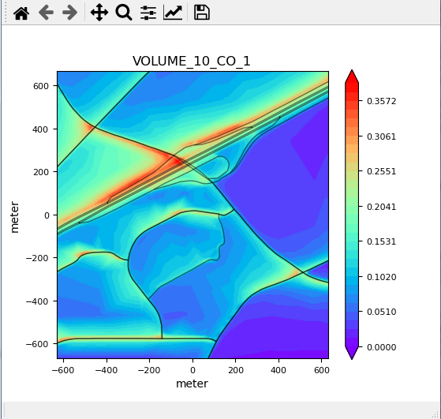
UI Design (8) – Results
Concentration Profile Visualization
GTA (GIS-TO-AERMOD)
Data
Road
Receptors
Emissions
Compilation
Results
Upload an AERMOD ‘.out’ file to organize and visualize
Upload AERMOD ‘.out’ file
D:\Research 2021\GIS-TO-AERMOD Tool\aermod.out
Organize into csv output
& visualize
Click this button will generate csv file, and open a new window with plot graph. CL1040-1102
Questions ?

Slide 41
UI Design (8) – Results
Info
The tool is developed by Dr. Haobing Liu (PI and algorithm design) and his graduate student Shiro Ishizu (UI design) at University of New Mexico. For technical questions, please contact:
Haobing Liu, Ph.D.
Assistant Professor
University of New Mexico
Email (1): hliu332@unm.edu
Email (2): Haobing.liu2012@gmail.com
The research is supported by Federal Highway Administration (FHWA). The project is managed by Donna Gililland at New Mexico Department of Transportation (NMDOT).
Version: 2021-03-31
GTA (GIS-TO-AERMOD)
Data
Road
Receptors
Emissions
Compilation
Results
Upload an AERMOD ‘.out’ file to organize and visualize
Upload AERMOD ‘.out’ file
D:\Research 2021\GIS-TO-AERMOD Tool\aermod.out
Organize into csv output
& visualize
Click this button will open a new window with TEXT
Questions ?

Slide 42
Buttons with Progress Bar
Add progress bars for all button functions that takes some time.
After click the button, the bar pops up while it is processing.
The bars will automatically close when the button processes is finished

Slide 43
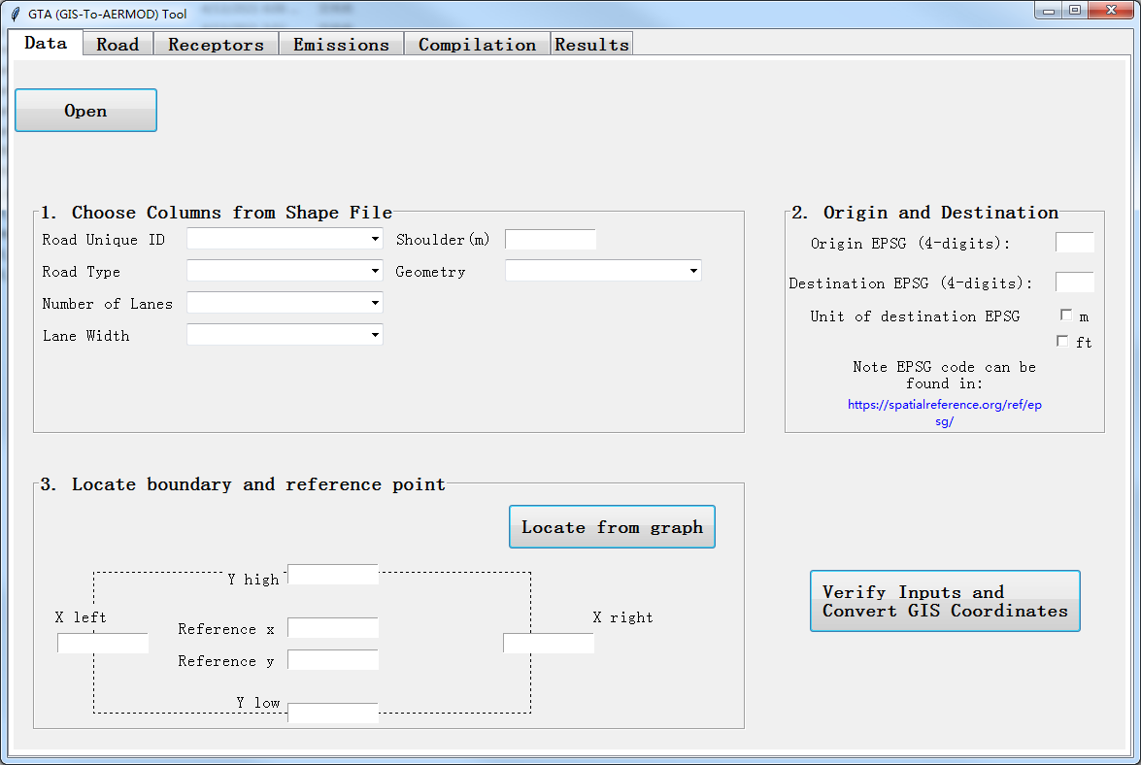
Buttons with Progress Bar
Processing
Projecting GIS coordinate system…

Slide 44
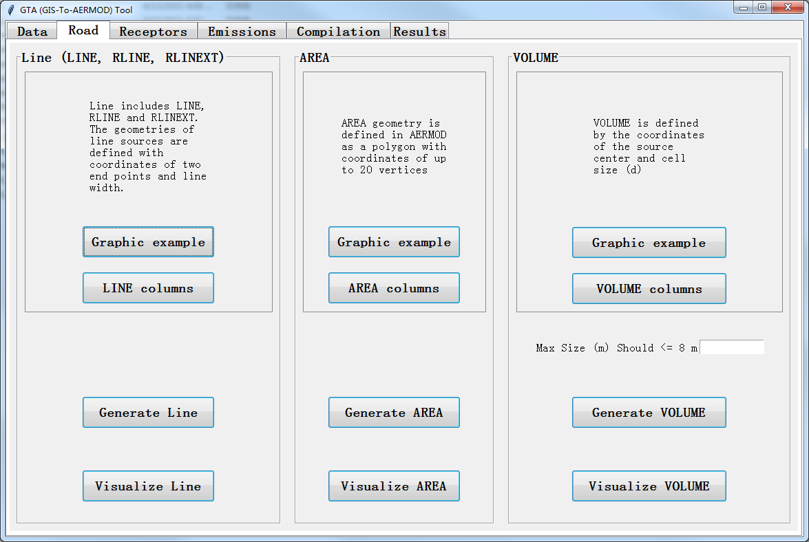
Buttons with Progress Bar
Processing
Generating geometry of Line source…

Slide 45
Buttons with Progress Bar
Processing
Generating graph for Line source…

Slide 46
Buttons with Progress Bar
Processing
[Bars for these, just change ‘Line’ to ‘AREA’ or ‘VOLUME’]

Slide 47
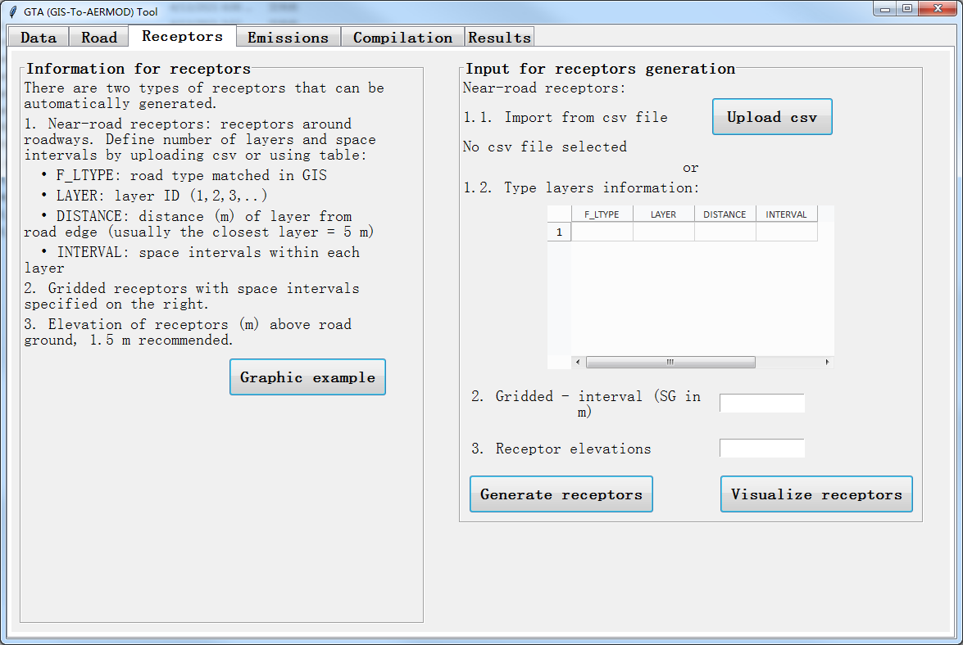
Buttons with Progress Bar
Processing
Generating near-road and gridded receptors…

Slide 48
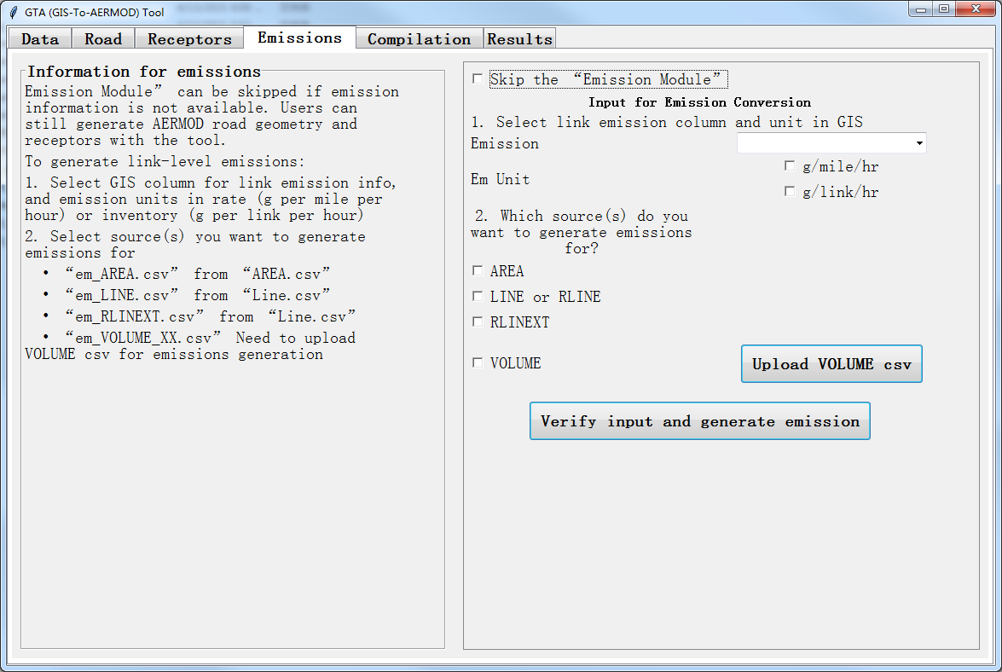
Buttons with Progress Bar
Processing
Generating AERMOD emissions…

Slide 49
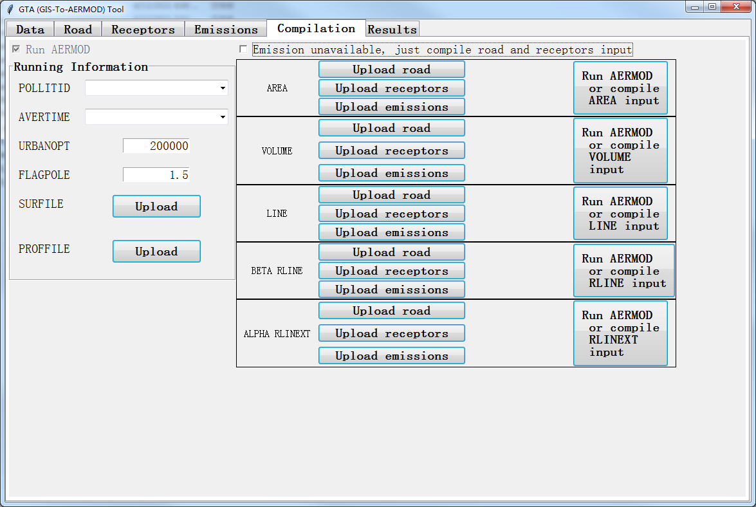
Buttons with Progress Bar
Processing
Running AERMOD or compiling AERMOD AREA input…
[Bars for these buttons, just change ‘AREA’ to ‘VOLUME’, ‘LINE’, ‘RLINE’ or ‘RLINEXT’]

Slide 50
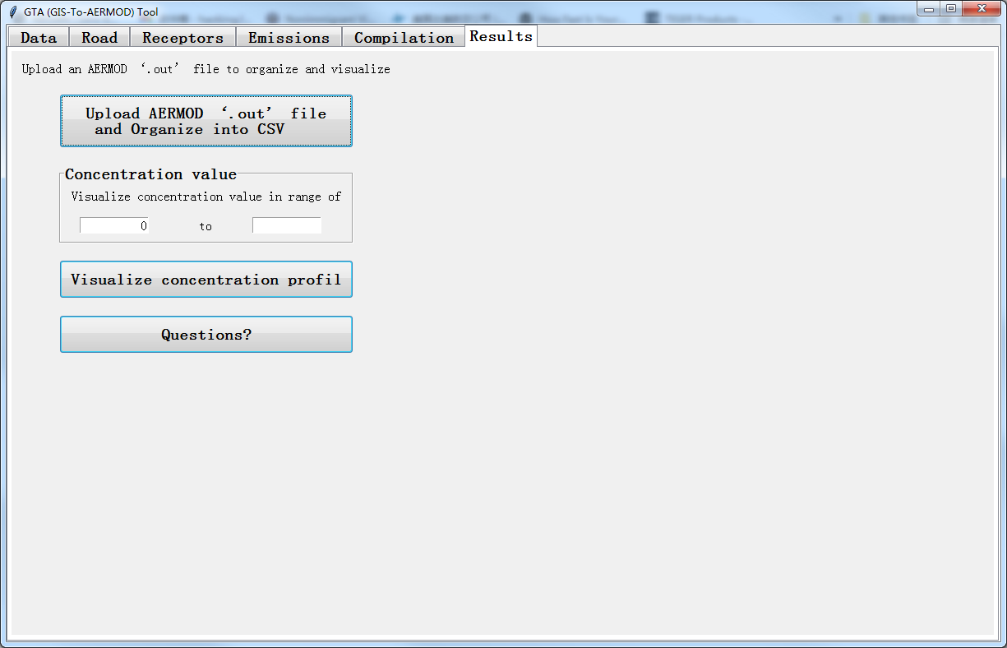
Buttons with Progress Bar
Processing
Organizing AERMOD output into CSV file…

Slide 51
Buttons with Progress Bar
Processing
Visualizing concentration profile …
Here should be ‘profile’. Maybe change the text to ‘visualize concentration’ with ‘profile’ removed in the button

Slide 52
Core tasks
Progress bars
Constrains and Warnings
Compile the ‘.exe’ into smaller version

Slide 53
Constrains and Warnings
1. Shoulder should be nonnegative number (float)
2. EPSG should be integer
If any error was found, when click the button, the error message pops up.
(Only show the message sentence with errors found)
Error
Please fix the following issue(s):
1. Shoulder should be nonnegative number (float)
2. EPSG should be integer
3. XY coordinates needs to be numbers (float)
3. XY coordinates needs to be numbers (float)
Confirm

Slide 54
Constrains and Warnings
Error
Maz Size should be any flow larger than 1 m, and recommended to be no larger than 8 m
Please fix the following issue:
Maz Size should be any flow larger than 1 m, and recommended to be no larger than 8 m
Confirm

Slide 55
Constrains and Warnings
2. SG should be positive number (float)
Error
3. Receptor elevation should be number (float).
Please fix the following issue:
2. SG should be positive number (float)
3. Receptor elevation should be number (float).
Confirm

Slide 56
Constrains and Warnings
URBANOPT should be a positive integer
Error
FLAGPOLE should be a positive number (float)
Please fix the following issue:
URBANOPT should be a positive integer
FLAGPOLE should be a positive number (float)
Confirm

